Slide 1
Introduction To Compiler
Course Code: CSC 3220
Course Title: Compiler Design
Dept. of Computer Science
Faculty of Science and Technology
Lecture No: | 2 | Week No: | 2 | Semester: | Fall 2023-2024
Lecturer: | Shahnaj Parvin sparvin@aiub.edu

Slide 2
Lecture Outline
Language Processing System
Different Phases of a Compiler

Slide 3
Objectives and Outcomes
Objectives:
Understand the structure of a language processing system.
Understand the structure of a compiler.
Understand the tools involved( Scanner generator, Parser generator, etc)
Outcomes:
Students should be able to understand how a language is processed step by step.
Students will analyze the phases of a compiler.

Slide 4
Language Processors
Computer can only understands instructions in machine code, i.e. in the form of 0s and 1s.
It is difficult to write computer program directly in machine code.
Nowadays, the programs are written mostly in high-level languages, i.e. BASIC, C, C#, Java, PASCAL, etc. A program written in any high-level programming language (or written in assembly language) is called the Source Program.

Slide 5
Language Processors
The source program must be converted into machine code to run it on the computer.
The program translated into machine code is known as Object Program.
Every language has its own language processor (or translator).
Therefore, language processor is defined as: The special translator system software that is used to translate the program written in high-level language (or Assembly language) into machine code is called language processor or translator program.

Slide 6
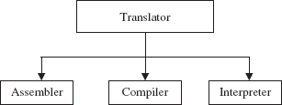
Language Processors
The language processor are divided intro three types-
Compilers
Interpreters
Assemblers

Slide 7
Language Processors (Compiler)
The language processor that translates the complete source program as a whole in machine code before execution is called compiler. The C and C++ compilers are best examples of compilers.
The program translated into machine code is called the object program.
The source code is translated to object code successfully if it is free of errors.
If there are any errors in the source code, the compiler specifies the errors at the end of compilation.
The errors must be removed before the compiler can successfully compile the source code.

Slide 8
Language Processors (Compiler)
Error & diagnostic message
Source program
Compiler
Target program
Source languages: Programming languages, FORTRAN, PASCAL, C, etc.
Target language: machine code for the Central processing unit being used (target machine).

Slide 9
Language Processors (Interpreter)
The language processor that translates (converts) each statement of source program into machine code and executes it immediately before to translate the next statement is called Interpreter.
If there is an error in the statement the interpreter terminates its translating process at that statement and displays an error message.
The OWBASIC is an example of interpreter.

Slide 10
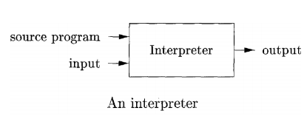
Language Processors (Interpreter)

Slide 11
Language Processors (Assembler)
An assembler is third type of translator program. It is used to translate the program written in Assembly language into machine code.
An assembler performs the translation process in similar way as compiler. But assembler is the translator program for low-level programming language, while a compiler is the translator program for high-level programming languages.

Slide 12
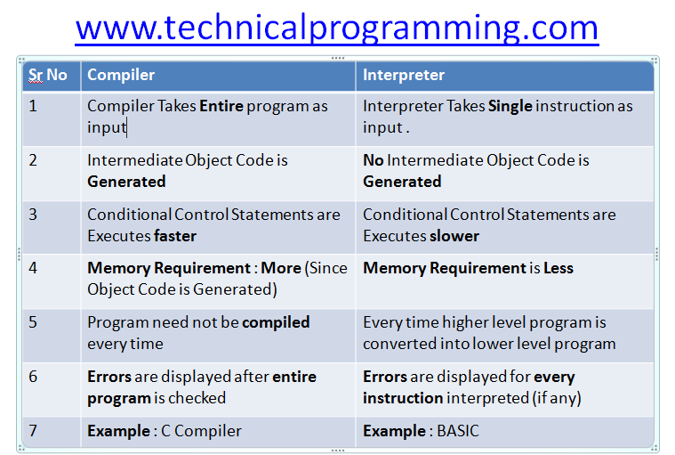
Difference between Interpreter & Compiler)

Slide 13
Hybrid Compiler
Hybrid compiler is a compiler which translates a human readable source code to an intermediate byte code for later interpretation. So these languages do have both features of a compiler and an interpreter. These types of compilers are commonly known as Just In-time Compilers (JIT).
Java is one good example for these types of compilers.

Slide 14
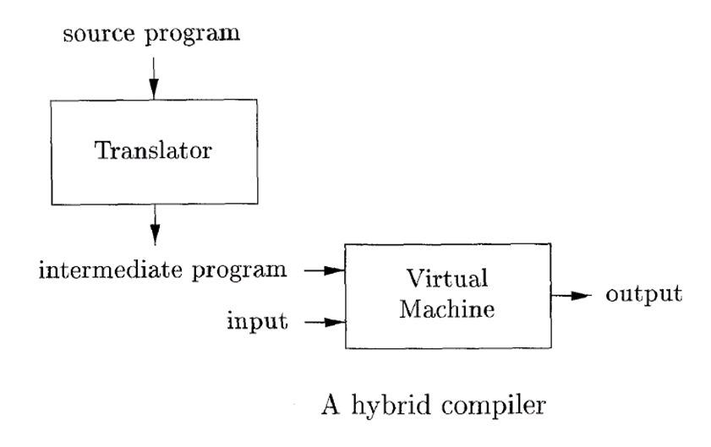
Hybrid Compiler
Java language processors combine compilation and interpretation.

Slide 15
Hybrid Compiler
A Java source program may first be compiled into an intermediate form called bytecodes. The bytecodes are then interpreted by a virtual machine.
A benefit of this arrangement is that bytecodes compiled on one machine can be interpreted on another machine, perhaps across a network.
In order to achieve faster processing of inputs to outputs, some Java compilers, called just-in-time compilers, translate the bytecodes into machine language immediately.

Slide 16
Language Processing System
Source Program
Preprocessor
Modified source program
Compiler
Target assembly program
Assembler
Relocatable machine code
Linker/ Loader
Absolute machine code
Target Program

Slide 17
Language Processing System
In addition to a compiler, several other programs may be required to create an executable target program.
A source program may be divided into modules stored in separate files.
The task of collecting the source program is sometimes entrusted to a separate program, called a preprocessor.

Slide 18
Language Processing System
In addition to a compiler, several other programs may be required to create an executable target program.
A source program may be divided into modules stored in separate files.
The task of collecting the source program is sometimes entrusted to a separate program, called a preprocessor.
A macro or "macro-instruction" in computer science is a rule or pattern that specifies how a certain input sequence (often a sequence of characters) should be mapped to a replacement input sequence (also often a sequence of characters) according to a defined procedure.

Slide 19
Language Processing System
The modified source program is then fed to a compiler.
The compiler may produce an assembly-language program as its output, because assembly language is easier to produce as output and is easier to debug.
The assembly language is then processed by a program called an assembler that produces re-locatable machine code as its output .It is also known as object files.

Slide 20
Language Processing System
Linker takes one or more object files or libraries as input and combines them to produce a single (usually executable) file.
The loader then puts together all of the executable object files into memory for execution.

Slide 21
Linker
In high level languages, some built in header files or libraries are stored.
These libraries are predefined and these contain basic functions which are essential for executing the program.
These functions are linked to the libraries by a program called Linker.
If linker does not find a library of a function then it informs to compiler and then compiler generates an error.

Slide 22
Loader
Loader is a program that loads machine codes of a program into the system memory.
In Computing, a loader is the part of an Operating System that is responsible for loading programs.
It is one of the essential stages in the process of starting a program. Because it places programs into memory and prepares them for execution.

Slide 23
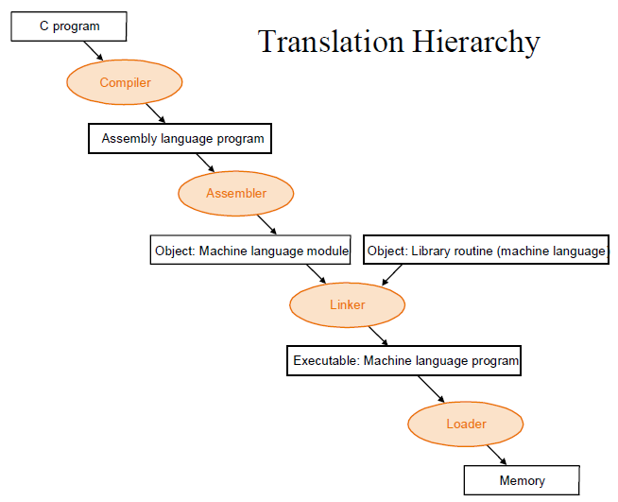

Slide 24
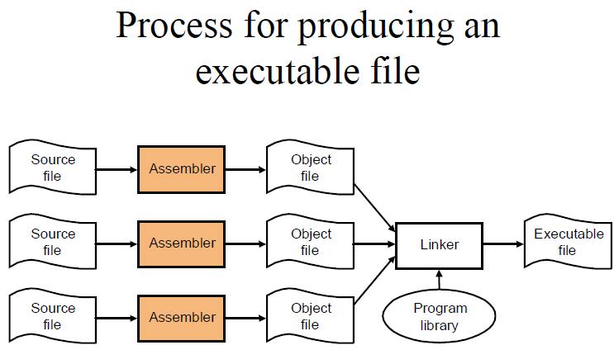

Slide 25
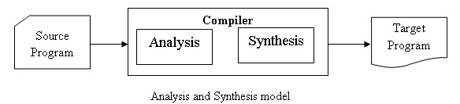
The Structure of a Compiler
Up to this point we have treated a compiler as a single box that maps a source program into a semantically equivalent target program.
If we open up this box a little, we see that there are two parts to this mapping: analysis and synthesis.

Slide 26
The Structure of a Compiler
The analysis part breaks up the source program into constituent pieces and imposes a grammatical structure on them.
It then uses this structure to create an intermediate representation of the source program.
If the analysis part detects that the source program is either syntactically ill formed or semantically unsound, then it must provide informative messages, so the user can take corrective action.

Slide 27
The Structure of a Compiler
The analysis part also collects information about the source program and stores it in a data structure called a symbol table, which is passed along with the intermediate representation to the synthesis part.
The synthesis part constructs the desired target program from the intermediate representation and the information in the symbol table.
The analysis part is often called the front end of the compiler; the synthesis part is the back end.

Slide 28
Lecture References
A. Aho, R. Sethi and J. Ullman, Compilers: Principles, Techniques and Tools
(The Dragon Book), [ Second Edition]

Slide 29
References
A. Aho, R. Sethi and J. Ullman, Compilers: Principles, Techniques and Tools(The Dragon Book), [ Second Edition]
Principles of Compiler Design (2nd Revised Edition 2009) A. A. Puntambekar
Basics of Compiler Design Torben Mogensen

